Slide 1
OBJECT ORIENTED PROGRAMMING
&
UML
Abin
6/8/12
(C) Scope International 2012 in association with Teknoturf Info Services Pvt. Ltd.

Slide 2
Introduction To OOP Concepts
Understanding different programming styles – Structured, OO, Event
Major and Minor themes of Object Orientation
  Encapsulation
  Abstraction
  Polymorphism
  Hierarchy - Inheritance
  Modularity - Packages
  Typing
  Persistence
Class and Objects
Object communication – Messages
Visibility – Access Specifiers

Slide 3
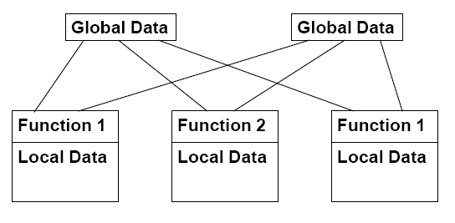
Procedure-Oriented Programming
Emphasis is on doing things (algorithms)
Large programs are divided into smaller programs (functions)
Most of the functions share global data
Data move openly around the system from function to function
Functions transform data from one form to another
Employs top-down approach in program design

Slide 4
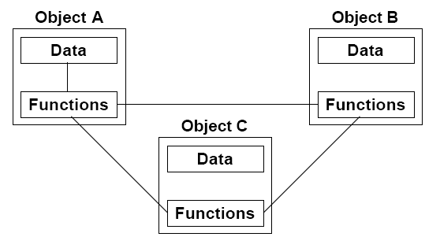
Object Oriented Programming
Emphasis is on data rather than procedure
Programs are divided into objects (abstracted into classes)
Data is encapsulated in the objects
Objects communicate with each other through functions (called methods)
Follows bottom-up approach in program design

Slide 5
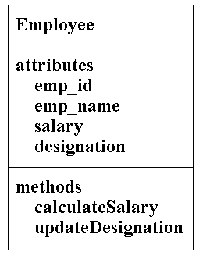
Class
A class is a template(specification, blueprint) for a collection of objects that share a common set of attributes and operations.
Example:
  Employee (shares common attributes and operation of all employees in a company)

Slide 6
Object
An instance is an executable copy of a class
Objects can be:
  Physical or conceptual
  Tangible or intangible
Example:
  Jerry, Sam, Tom are all objects of Employee
Characteristics of Object
  Identity - Identity is that property of an object which distinguishes it from all others.
  State - The state of an object consists of a set of data fields (its properties) with their current values.
  Behaviour - Behavior is how an object acts and reacts in terms of its state changes and message passing.

Slide 7
Object Communication
Software objects communicate and interact with each other in two ways:
  by calling (or invoking) each other's methods
  by directly accessing their variables.
Message Passing
  Object A calls a method implemented by object B to have it to perform some behavior or return some value.
  There are three parts to calling a method:
    The object you are calling that implements the method (e.g., the CD app object)
    The name of the method to perform (e.g., play)
    Any arguments needed by the called object (e.g., the CD track #)

Slide 8
Object Communication
Visibility
  Visibility is the scope of the attribute.
  It could take the following values:
    -: for private - are variables that are visible only to the class to which they belong.
    + : for public - are variables that are visible to all classes.
    # : for protected - are variables that are visible only to the class to which they belong, and any subclasses.

Slide 9
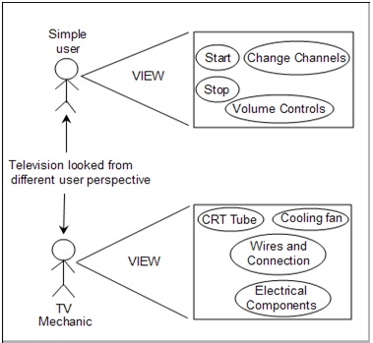
Principles Of OOP - Abstraction
Abstraction is a fundamental principle of modelling.
Abstraction, as a process, denotes the extracting of the essential details about an item, or a group of items, while ignoring the inessential details.
Hiding details so as not to confuse the bigger picture

Slide 10
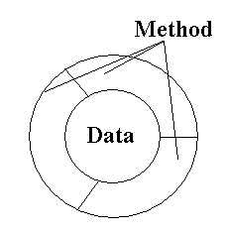
Principles Of OOP - Encapsulation
Encapsulation allows the programmer to group data and the subroutines that operate on them together in one place, and to hide irrelevant details from the user (just like a capsule).
Each objects methods manage it’s own attributes.
Maximizes maintainability, reuse, extension , coherence

Slide 11
Principles Of OOP - Polymorphism
Polymorphism means having multiple forms
It is the characteristic of being able to assign a different meaning or usage to something in different contexts specifically, to allow an entity such as a function, or an object to have more than one form
Two ways of implementing Polymorphism – Compile time polymorphism and Run time polymorphism
Example:
  Person
    Student
    Employee
    Son
    Daughter

Slide 12
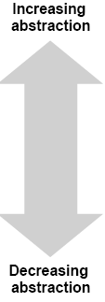
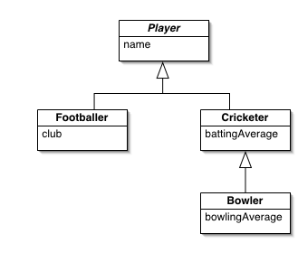
Principles Of OOP - Hierarchy
Hierarchy is a ranking or ordering of abstractions.
Types
  Inheritance or class structure hierarchy
    Represents “is a”or “is a type of”relationship between two classes. Features that are common to many classes are migrated to a base class

Slide 13
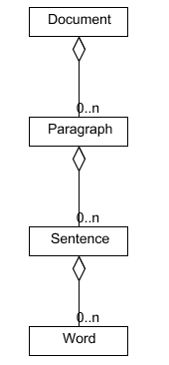
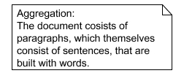
Principles Of OOP - Hierarchy
  Aggregation or object structure hierarchy
    Represents the “is a part of”or “whole-part”relationship where one object becomes a part of other object.

Slide 14
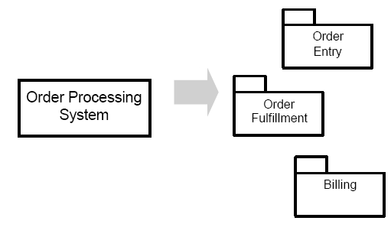
Principles Of OOP - Modularity
Modularity is the property of a system that has been decomposed into a set of cohesive and loosely coupled modules.
Modularity can be defined as the process of breaking up of a complex system into small, self contained Pieces that can be managed easily
A collection of related classes called as packages.

Slide 15
Principles Of OOP – Typing , Persistence
Typing
  Is the enforcement of the class of an object, such that objects of different types may not be interchanged, or at the most, they may be interchanged only in restricted ways.
  Examples of Typing: Strongly Typed and Weakly typed
Persistence:
  Is the property of an object through which its existence transcends in time.(i.e. Object continues to exist after its Creator ceases to exist) and/or space.(i.e Object’s locationmoves from the address space in which it was created.)

Slide 16
UML
Modeling
UML Introduction
UML view
UML Diagram
  Usecase Diagram
  Class Diagram
  Interaction Diagram
  Deployment Diagram
  Component Diagram
  Package Diagram
  Activity Diagram
  StateChart Diagram

Slide 17
Modeling
Modeling is a way of thinking about the problems using models organized around the real world ideas.
A modeling method comprises a language and also a procedure for using the language to construct models.
modeling is the only way to visualize your design and check it against requirements before your crew starts to code.

Slide 18
UML
UML – Unified Modeling Language is a Standard language for specifying, visualizing, constructing, and documenting the artifacts of software systems, business modeling and other non-software systems
UML is a pictorial language used to make software blue prints.
It is not simply a notation for drawing diagrams, but a complete language for capturing knowledge (semantics) about a subject and expressing knowledge (syntax) regarding the subject for the purpose of communication.
Applies to modeling and systems. Modeling involves a focus on understanding a subject (system) and capturing and being able to communicated in this knowledge.

Slide 19
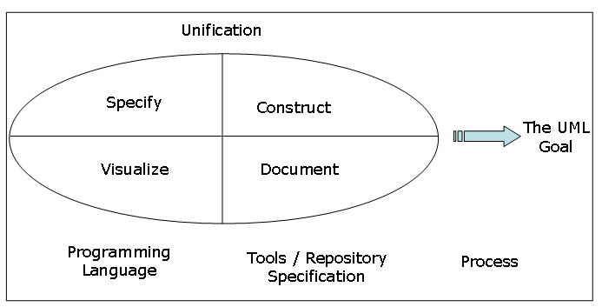
UML

Slide 20
UML Architecture
User View
  Models which define a solution to a problem as understood by the client or stakeholders.
  Use Case Diagram
Structural View
  Models which provide the static, structural dimensions and properties of the modelled system.
  Class diagram, Object diagram
Behavioural View
  Models describe the behavioural and dynamic features and methods of the modelled system.
  Interaction diagram( sequence diagram, Collaboration diagram) , Activity diagram, state chart diagram

Slide 21
UML Architecture
Implementation View
  View combines the structural and behavioral dimensions of the solution realization or implementation.
  Component diagram, package diagram
Environment view
  Models describe both structural and behavioural dimensions of the domain or environment in which the solution is implemented.
  Deployment diagram

Slide 22
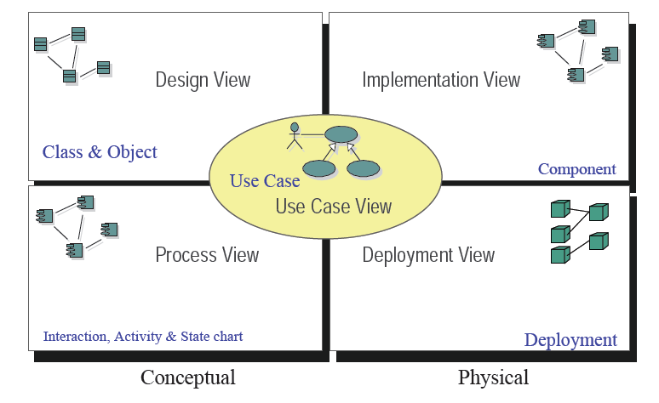
UML

Slide 23
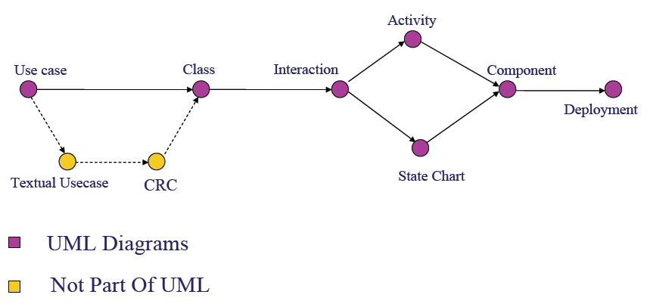
UML

Slide 24
Use Case Diagram
depicts different users of the system and the functions of the system.
Use case diagram expose the requirements of the system.
Actors interact with a use case and the functions are called as use cases.
Use cases diagrams describe the interaction between the actor and the use case.

Slide 25



Use Case Diagram
Components
Actor : which represent users of a system, including human users and other systems.
Usecase : which represent functionality or services provided by a system to users.
Association :Associations between actors and use cases are indicated by solid lines. An association exists whenever an actor is involved with an interaction described by a use case.

Slide 26


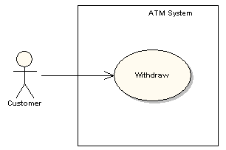
Use Case Diagram
Includes : Use cases may contain the functionality of another use case as part of their normal processing. In general it is assumed that any included use case will be called every time the basic path is run.
Extends : One use case may be used to extend the behavior of another; this is typically used in exceptional circumstances.
System Boundary :It is usual to display use cases as being inside the system and actors as being outside the system.

Slide 27
Use Case Specification
Use case name - States the use case name.
Use case actor - Actor interacting with the use case
Preconditions - A state of the system that must be present before a use case is performed.
Basic flow of events - Describes the ideal, primary behavior of the system.
Alternative flow of events - Describes exceptions or deviations from the basic flow,
Post conditions - A list of possible states for the system immediately after a use case is finished.
Extension points - A point in the use-case flow of events at which another use case is referenced

Slide 28
Class Diagram
Class Diagrams describe the static structure of a system, or how it is structured rather than how it behaves. These diagrams contain the following elements.
  Classes, which represent entities with common characteristics or features. These features include attributes, operations and associations.
  Associations, which represent relationships that relate two or more other classes where the relationships have common characteristics or features. These attributes and operations.

Slide 29
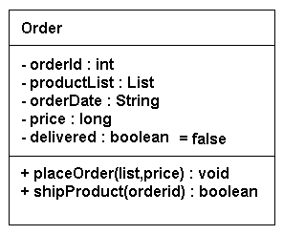
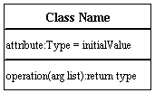
Class Diagram
Class Notation

Slide 30
Class Diagram
Relationship
  Relationships connect two or more things. In object orientation its connections between two elements.
  types of relationship among classes
    Association
    Inheritance or Generalization
    Aggregation
    Composition
    Dependency
    Realization

Slide 31

Class Diagram
The association relationship is a simple relationship. It connects two classes , denoting the structural relationship between them. An association is shown as a line connecting the related classes.
Multiplicity
  The number of instances of the class, next to which the multiplicity expression appears, that are referenced by a single instance of the class that is at the other end of the association path.
  Indicates whether or not an association is mandatory.
  Provides a lower and upper bound on the number of instances.

Slide 32

Class Diagram
Multiplicity Indicators
Exactly one | 1
Zero or more (unlimited) | * (0..*)
One or more | 1..*
Zero or one (optional association) | 0..1
Specified range | 2..4
Multiple, disjoint ranges | 2, 4..6, 8

Slide 33
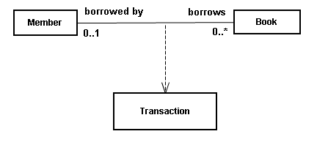
Class Diagram
Association class
  we can also show an association class in an association relationship. An association class is one that makes it possible for the association to exist between two other classes.

Slide 34

Class Diagram
Dependency
  Is the “using”or “uses”relationship where one element is using another element to get its task done. A change in one element affects the another element that uses it. i.e. if the one changes then it affects the other element. The reverse need not be true.
  The dependency from CourseSchedule to Course exists because Course is used in both the add and remove operations of CourseSchedule.

Slide 35
Class Diagram
Aggregation
  The class at one end of the relationship will contain classes at the other end of the relationship. It is also called a whole part relationship. Signifies the “part of”or “has a”relationship.
  Examples:
    A room has a door.
    Building has rooms.
    Vehicle has an engine.
    Company has departments
    Book has chapters.
Two forms of Aggregation:
  Simple Aggregation
  Composition

Slide 36


Class Diagram
Aggregation
Composition – stronger form of aggregation The Whole is Sole responsible for the part

Slide 37

Class Diagram
Inheritance
  Generalization consists of the super class and sub-class relationship.
  The super class represents a general concept while the sub class represents a more specific concept.
  Also called as “is a type of ”.
  Examples:
    Rose is a type of flower.
    Windows is a kind of operating system.

Slide 38
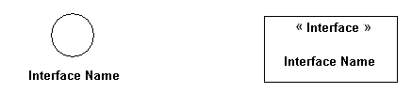

Class Diagram
Realization
  The relationship between the class and the interface. An interface is formally equal an abstract class with no attributes and methods(implementations ), only abstract Operations.

Slide 39
Interaction Diagram
Visualize the interactive behaviour of the system
Purpose of interaction diagram
  To capture dynamic behaviour of a system.
  To describe the message flow in the system.
  To describe structural organization of the objects.
  To describe interaction among objects.
Interactive behaviour is represented in UML by two diagrams known as Sequence diagram and Collaboration diagram.

Slide 40
Sequence Diagram
Used to show how objects interact in a given situation. An important characteristic of a sequence diagram is that time passes from top to bottom
Is an interaction diagram that emphasizes the time ordering of messages.
Graphically a sequence diagram is a table that shows objects arranged along X axis and messages, ordered in increasing time, along the Y axis.
Can model simple sequential flow, branching, iteration, and concurrency.

Slide 41
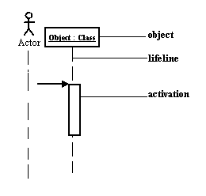
Sequence Diagram - Notation
Object – instance of the class participating in interaction
Lifeline - The lifeline represents the object's life during the interaction.
Activation - Activation box represent the time an object needs to complete a task.

Slide 42
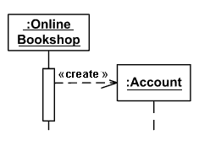
Sequence Diagram - Notation
Messages
Create
Create message is a kind of message that represents the instantiation of (target) lifeline.

Slide 43
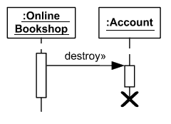
Sequence Diagram - Notation
Destroy
Destroy message is a kind of message that represents the request of destroying the life cycle of target lifeline.

Slide 44
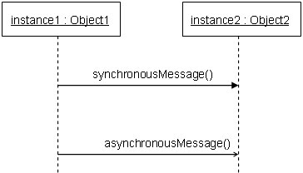
Sequence Diagram - Notation
Synchronous call
  It must wait until the message is done, such as invoking a subroutine.
Asynchronous call
  It can continue processing and doesn’t have to wait for a response.

Slide 45
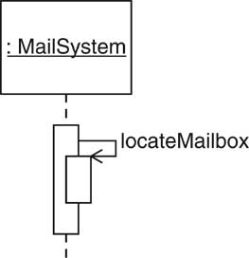
Sequence Diagram - Notation
Self call
  A self message can represent a recursive call of an operation, or one method calling another method belonging to the same object.

Slide 46
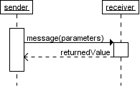
Sequence Diagram - Notation
Return message
Return message is a kind of message that represents the pass of information back to the caller of a corresponded former message.

Slide 47
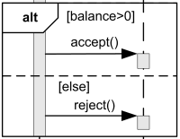
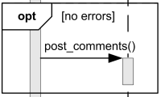
Sequence Diagram - Notation
Alt – shows the true and the false logic flow
Opt - The interaction operator opt means that the combined fragment represents a choice of behavior where either the (sole) operand happens or nothing happens.

Slide 48
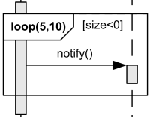
Sequence Diagram - Notation
The loop operand will be repeated a number of times.
The loop is expected to execute minimum 5 times and no more than 10 times. If guard condition [size<0] becomes false loop terminates regardless of the minimum number of iterations specified.

Slide 49
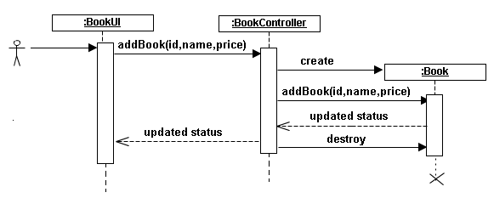
Sample Sequence Diagram

Slide 50
Collaboration Diagram
Models the dynamic behavior of the use case.
When compare to Sequence Diagram, the Collaboration Diagram is more focused on showing the collaboration of objects rather than the time sequence.
It shows the interaction of the objects and also the group of all messages sent or received by an object. This allows us to see the complete set of services that an object must provide.
Method call sequence is indicated by some numbering technique as shown below.
The number indicates how the methods are called one after another.

Slide 51
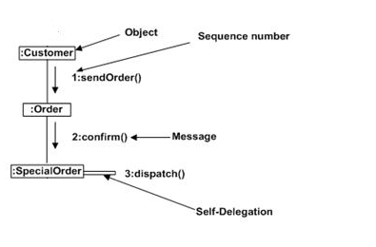
Collaboration Diagram

Slide 52



Activity Diagram
An activity diagram illustrates the dynamic nature of a system by modeling the flow of control from activity to activity.
An activity represents an operation on some class in the system that results in a change in the state of the system.
Activity diagrams are used to model workflow or business processes and internal operation
Notations
  Initial state
  Final state
  Action state

Slide 53
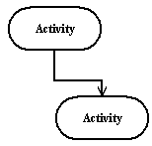
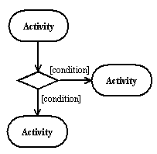
Activity Diagram
  Action flow
  Branching

Slide 54
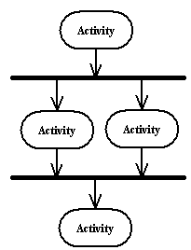
Activity Diagram
Synchronization
  A synchronization bar helps illustrate parallel transitions. Synchronization is also called forking and joining.
fork
merge

Slide 55
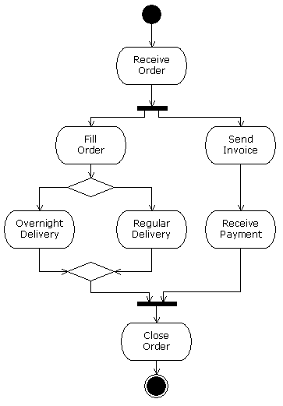
Activity Diagram

Slide 56
State Chart Diagram
Used to model dynamic nature of a system.
They define different states of an object during its lifetime.
purpose of Statechart diagram:
  To model dynamic aspect of a system.
  To model life time of a reactive system.
  To describe different states of an object during its life time.
  Define a state machine to model states of an object.

Slide 57

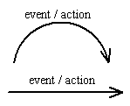
State Chart Diagram
Notation
States - States represent situations during the life of an object.
Transition - A solid arrow represents the path between different states of an object.

Slide 58
State Chart Diagram
Initial State -A filled circle followed by an arrow represents the object's initial state.
Final State - An arrow pointing to a filled circle nested inside another circle represents the object's final state.

Slide 59
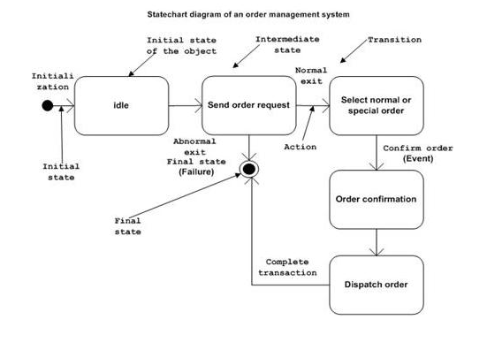

Slide 60
Component Diagram
Component diagrams are used to model physical aspects of a system.
Physical aspects are the elements like executables, libraries, files, documents etc which resides in a node.
component diagrams are used to visualize the organization and relationships among components in a system. These diagrams are also used to make executable systems.
Component diagrams are used during the implementation phase of an application.

Slide 61


Component Diagram
Notations
Component -A component is a physical building block of the system
Interface -An interface describes a group of operations used or created by components.

Slide 62
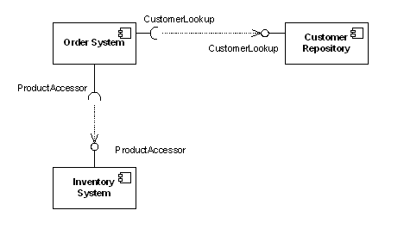
Component Diagram
Dependencies
  A component diagram that shows how the Order System component depends on other components

Slide 63

Component Diagram
Assembly Connector - The assembly connector bridges a component’s required interface (Component1) with the provided interface of another component (Component2).This allows one component to provide the services that another component requires.

Slide 64
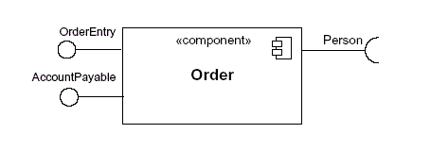
Component Diagram
Components with Ports -
  the interface symbols with a complete circle at their end(ports) represent an interface that the component provides.
  Interface symbols with only a half circle at their end(sockets) represent an interface that the component requires
  the Order component provides two interfaces: OrderEntry and AccountPayable, and the Order component requires the Person interface.

Slide 65
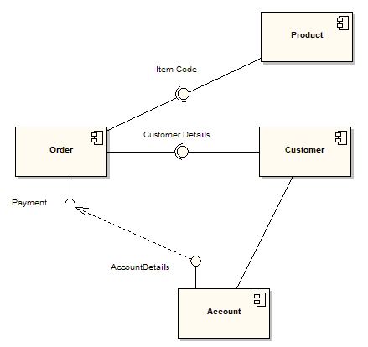
Component Diagram

Slide 66
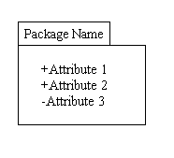

Package Diagram
Package diagrams organize the elements of a system into related groups to minimize dependencies among them.
Notations
  Package

Slide 67
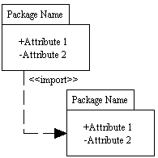
Package Diagram
Dependency
  Dependency defines a relationship in which changes to one package will affect another package.

Slide 68
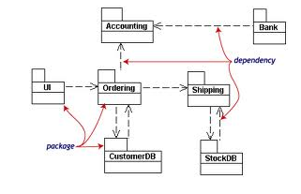
Package Diagram

Slide 69
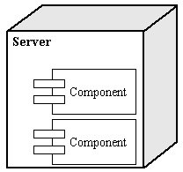
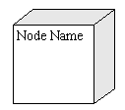
Deployment diagram
The deployment diagram shows how a system will be physically deployed in the hardware environment. Its purpose is to show where the different components of the system will physically run and how they will communicate with each other.
Notation
Node - A node is a physical resource that executes code components.

Slide 70
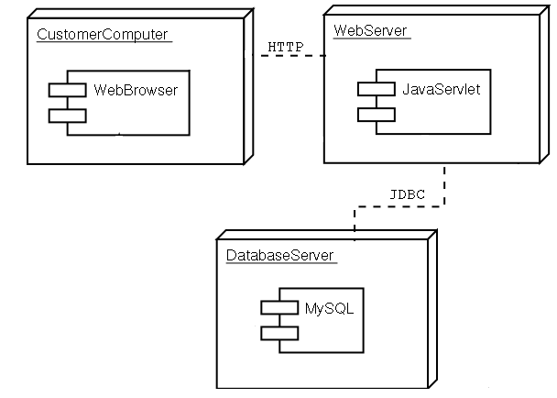
Deployment diagram

